Slide 1




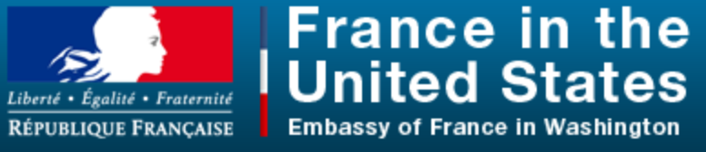
The Global Alliance for Clean Cookstoves and the Solar Cooking community :
Towards greater collaboration
Monday, June 23, 2014
Washington, DC
Project funded by

Slide 2
Content
A brief presentation of each organization
An outline of solar cooking solutions and projects
SolSource technology by OED
Mission, objectives and proposed solutions
A « questions / answers » exchange

Slide 3
A brief presentation
Solar Household Energy (USA – Washington DC)
Solar Cookers International (USA – Sacramento)
One Earth Design (USA – Boston)
Bolivia Inti – Sud Soleil (France – Nantes)

Slide 4
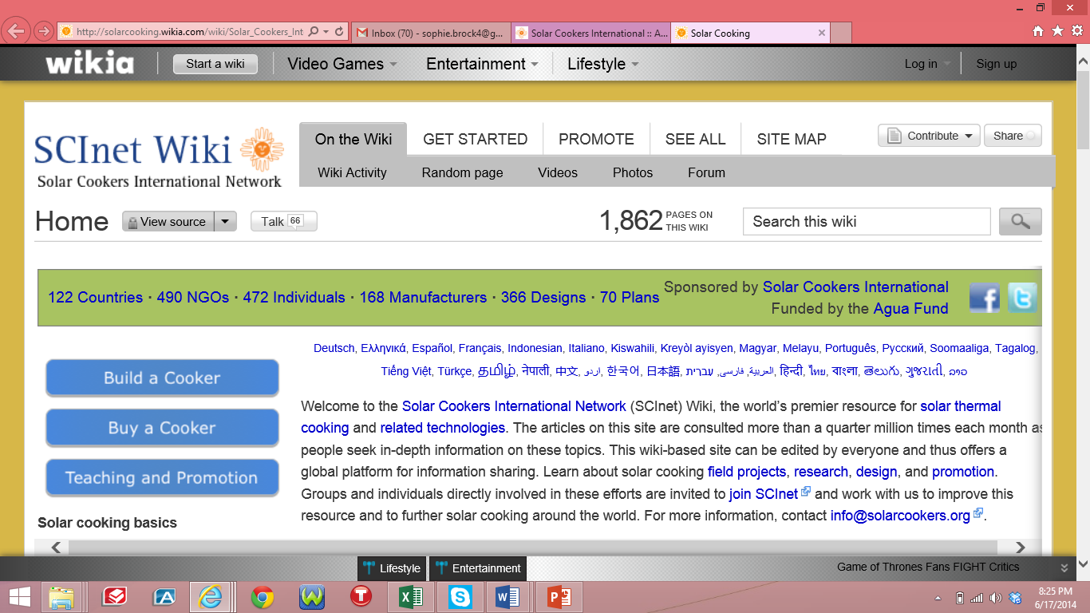
Solar cooking Wiki

Slide 5
Content
A brief presentation of each organization
An outline of solar cooking solutions and projects
SolSource technology by OED
Mission, objectives and proposed solutions
A « questions / answers » exchange

Slide 6
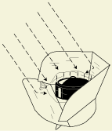
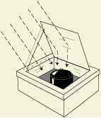


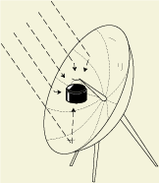


Solar thermal energy basics
Convert sunlight
to heat energy
Retain heat
Capture extra sunlight
Notes:
6

Slide 7
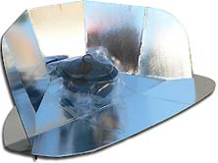
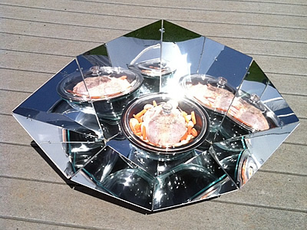
Solar panel cookers
T: 250-300 F; for slow, even-heat, hands-free cooking
Cookit
HotPot
Aluminum foil, cardboard, plastic bag, any black pot
Anodized aluminum, pyrex bowl, black enamelware – 10 year lifespan

Slide 8
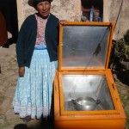
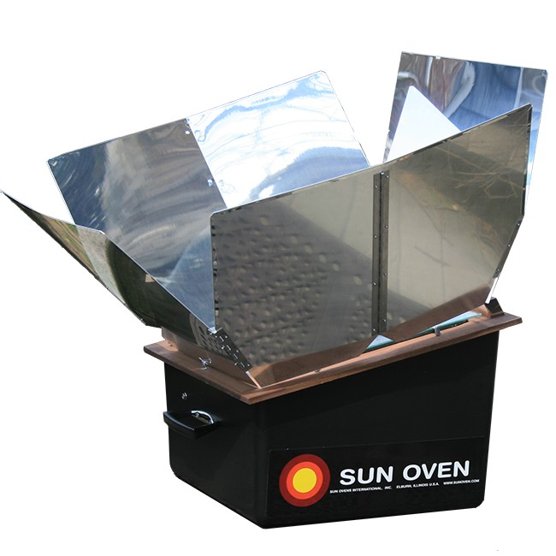
Solar ovens
T: 300-400 F; good heat retention for baking, cooking, even on partly cloudy days
Solar oven by BISS
Global Sun Oven
Made from local wood, llama wool for insulation
Tested by Sandia National Laboratories. Over 20-year lifespan.
Notes:
Photos from:
http://blog.terra-symbiosis.org/visite-des-beneficiaires-des-cuiseurs-solaires-de-bolivia-inti-sud-soleil-juillet-2011/
http://www.sunoven.com/all-american-sun-oven

Slide 9
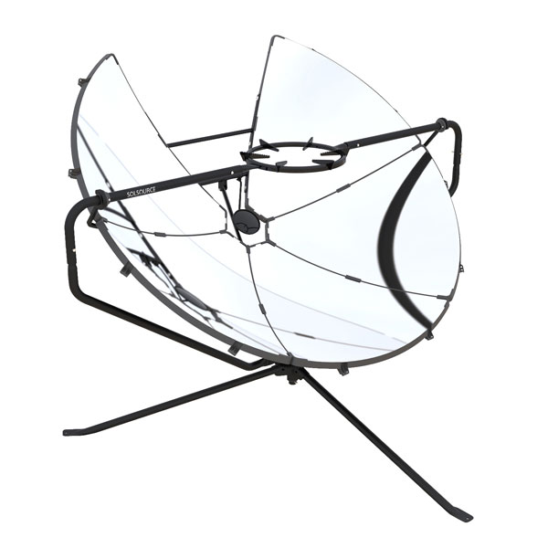
Parabolic solar stoves
T: 500-900 F; “solar flames” under the pot; Can fry, sautée, grill; dawn to dusk
Ningxia Hui solar cooker
SolSource
Locally made with concrete base, mirror pieces
High-quality, durable, award-winning solar grill by One Earth Designs
Notes:
Ningxi Hui solar cooker photo from:
Firstclimate insights. “Looking beyond size – projects in the Post 2012 Carbon Credit Fund.” March 2010. p.8. Accessed November 2011. http://www.firstclimate.com/fileadmin/downloads/newsletter/fci/2010/FC_Insights_20100301_post2012.pdf

Slide 10
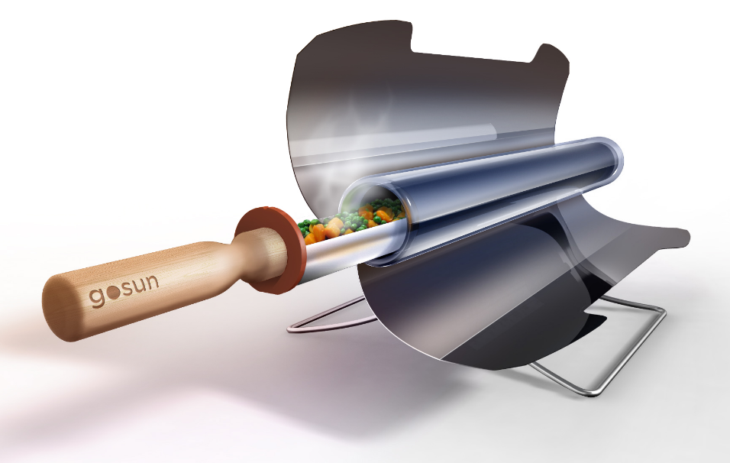
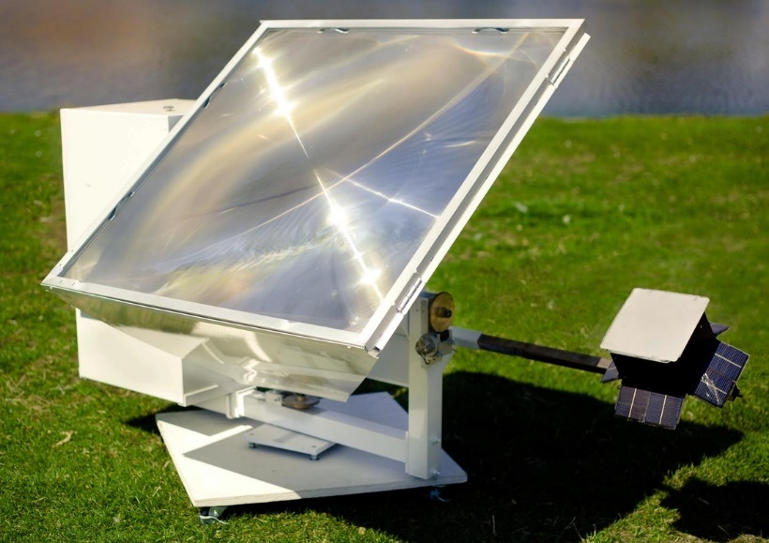
Less common types of solar cookers
Tube cooker – heats quickly, retains heat
Fresnel lens – glass or plastic light focusing
GoSun Stove
California Sunlight
T: 550 F; 5 lbs;
1.6 liter capacity
Automatic sun tracking, accessories for baking, frying, water distillation, AC power system
Notes:
Photos from:
http://www.gosunstove.com/
http://california-sunlight.com/core-products.html

Slide 11
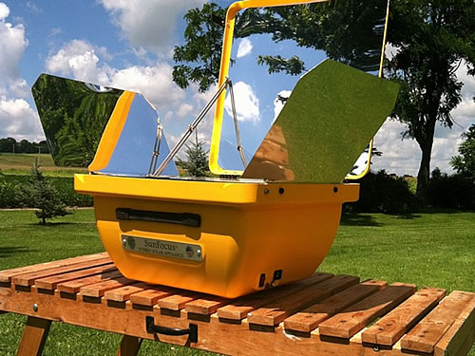
Solar / electric hybrid cookers
Can run on electricity
Produces electricity
SunFocus
Electro
Can be plugged in for electric back-up, 75% more energy-efficient than in-home oven
Built-in 10 W photovoltaic panels and battery for charging cell phone, radio, 15 hours of light
Notes:
Photos from:
http://www.sunbdcorp.com/products_sunfocus.php
http://www.sunoven.com/around-the-world/sunovens/villagers-sun-ovens
http://img3.wikia.nocookie.net/__cb20130105204252/solarcooking/images/7/75/Electro_solar_cooker_-_technical_specifications_and_photographs-2.pdf

Slide 12
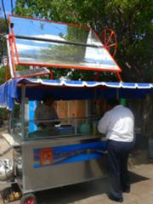
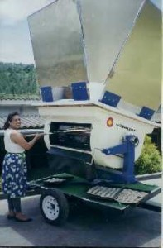
Solar / gas hybrid cookers
Natural gas hybrid
Propane back-up
Taqueria Poncho
Villager Sun Oven
Solar foodstall used by street vendors in Mexico
Saves 60-70% natural gas
1200 meals a day or hundreds of bread loaves
Propane back-up
Notes:
http://www.sunoven.com/around-the-world/sunovens/villagers-sun-ovens
http://solarcooking.wikia.com/wiki/Taqueria_Poncho,_solar_street_vendor

Slide 13
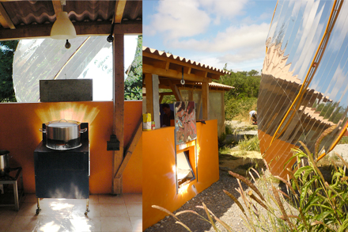
Fixed focus solar cookers
Auto-rotating dish allows for indoor community cooking
Scheffler 10m² dish with mechanical sun tracking
10 m² diameter dish focuses sunlight onto mirror under pot
Power 3.3 kW
Cooks 50 meals
Clockwork mechanism adjusted once a day for sun tracking

Slide 14
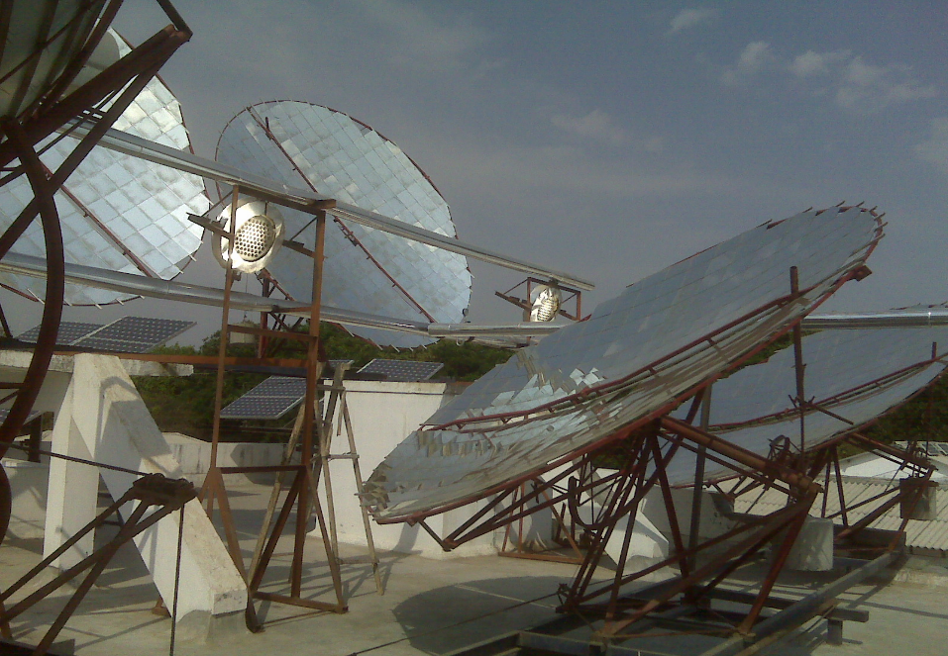
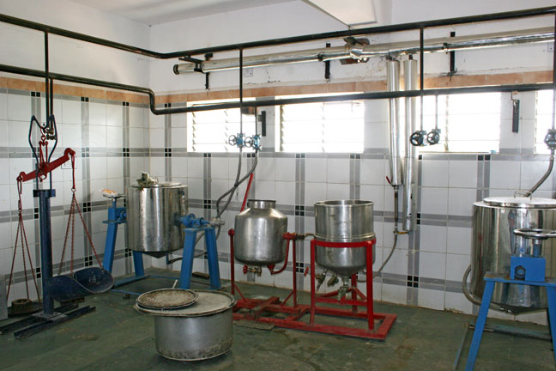
Solar steam/thermic fluid systems
650 C steam or thermic fluid is piped down to kitchens for institutional cooking
Scheffler dishes at Muni Seva Ashram
Solar cooking vessels steam direct injection, jacketed for steam/ thermic fluid

Slide 15
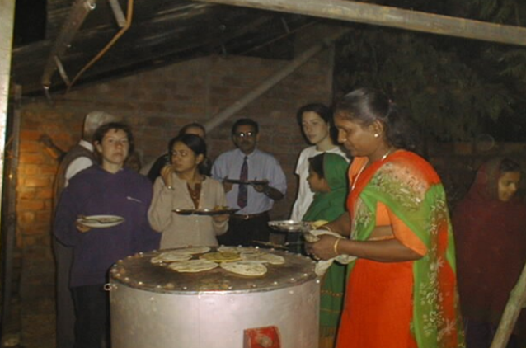
Heat storage with fluid thermic systems
Cooking at night with stored solar energy at Muni Seva Ashram

Slide 16
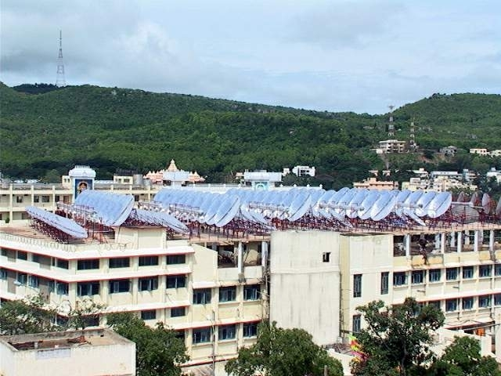
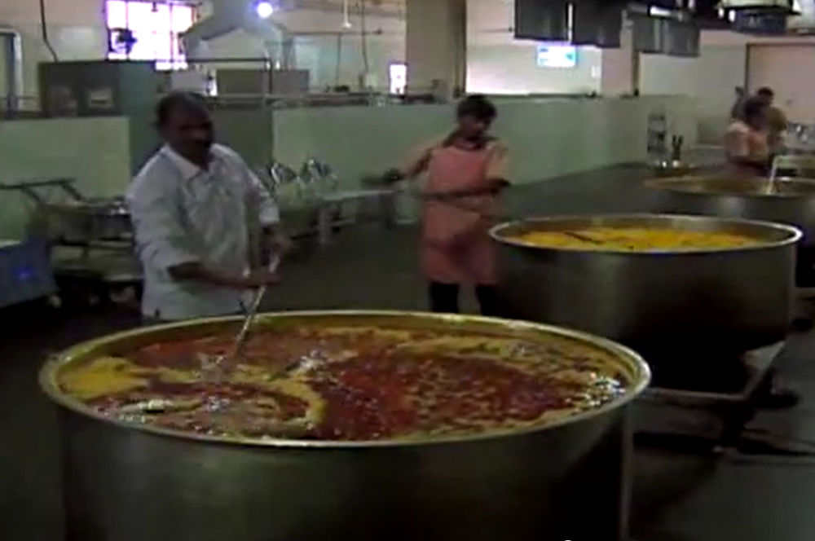
World’s largest solar cooking system
Solar cooking for 100,000 at Shirdi Sai Baba Temple

Slide 17
Solar cookers solutions
Solar cookers… | Panel | Oven | Parabolic | Solar/gas hybrid | Steam systems
Cook as fast as fire/gas | 2-3x longer | 1.5x longer
Work after dawn, before dusk | N | Keeps food hot
Work on partly cloudy days | not well
Fry and grill foods | N | N
Cook indoors, at night | N | N | N
Save cooking labor |  |  | N | N | N
DIY from cheap common materials |  |  |  | N | N
There is a huge diversity in solar cookers and their properties!

Slide 18
Research needs
Materials research for cheaper, more durable:
- Greenhouse material (eg. plastic, glass) - UV-resistant, transparent, light, unbreakable
- Reflective material (eg. mylar, aluminum foil)
- Glass or plastic fresnel lenses
- Heat storage options (molten salt, etc..)
Simple sun tracking methods
Efficient hybridization with other energy sources
NB: Most of the world’s energy needs are for heating, which can be met through solar thermal technology 2 to 3 times more efficiently than through solar PV.
Notes:
18

Slide 19
Biggest solar cooking projects
INDIA – over 340,000 government-subsidized solar cookers up to 1994. CDM-registered Gadhia institutional cookers for 28,000 people in 18 locations (2009), plus solar cooking for 100,000 at Shirdi Ashram.
CHINA – over 1.4 million solar cookers (2009 CAREI). Since 2009: CDM projects for 305,800 already implemented, plus 243,000 CDM registered (SHE 2014)
MADAGASCAR : ADES / 50’000 solar cooking ovens / project registered by Gold Standard
BOLIVIA/PERU : Bolivia Inti – Sud Soleil / 20’000 Solar cooking ovens / Project in both countries registered by Gold Standard
CHAD – « Cookit » solar cookers for over 50,000 refugees.

Slide 20
Content
A brief presentation of each organization
An outline of solar cooking solutions and projects
SolSource technology by OED
Mission, objectives and proposed solutions
A « questions / answers » exchange

Slide 21
Content
A brief presentation of each organization
An outline of solar cooking solutions and projects
SolSource technology by OED
Mission, objectives and proposed solutions
A « questions / answers » exchange

Slide 22
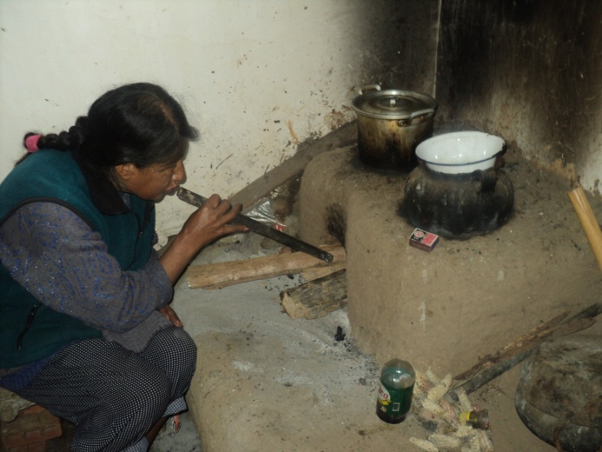
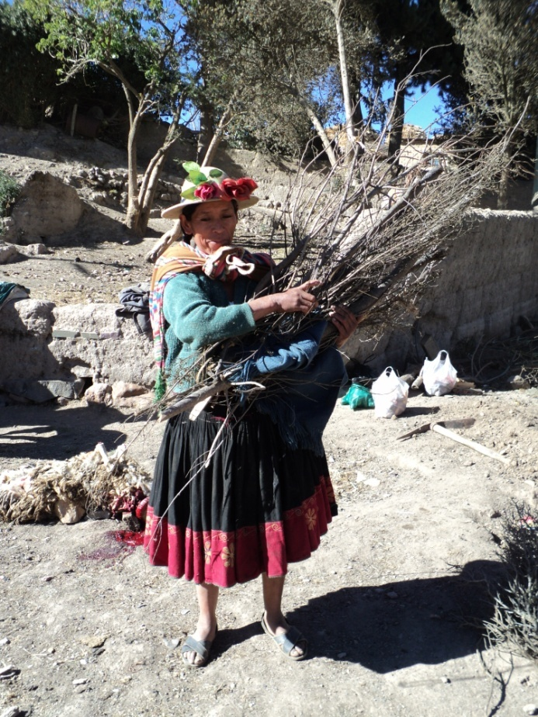
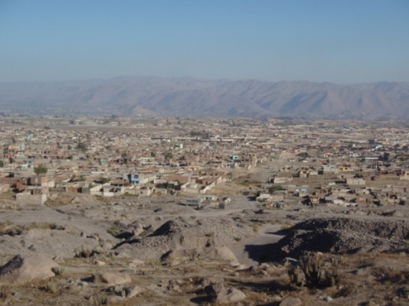
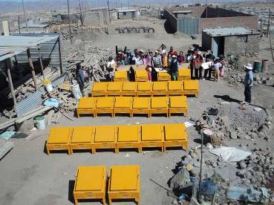
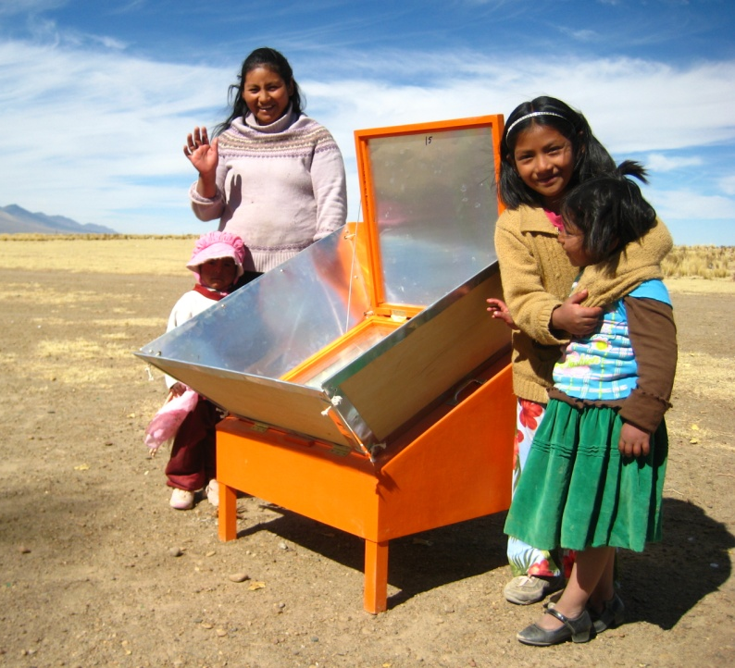
To scale up access and create a global market for solar cooking solutions through closer collaboration with the Global Alliance for Clean Cookstoves
Our mission
HEALTH
IMPACTS
ENVIRONMENTAL
IMPACTS
CLIMATE
IMPACTS
LIVELIHOOD
IMPACTS
GENDER
IMPACTS

Slide 23
Our objectives
1. To share solar cooking resources and lessons learned to benefit the Global Alliance and its partners.
3. To co-create tools, standards and resources meeting needs of GACC and SC community.
2. To share Global Alliance resources with SC community to advance SC projects and commercialization.

Slide 24
Objectives
Proposed solutions
Greater representation of solar cooking community (SCC) within Global Alliance for Clean Cookstoves (GACC)
Joint collaboration in reaching out to Solar cookers organizations to engage them to register with GACC as partners and contribute to Global Alliance knowledge-sharing platforms, including reports, research, clean cookstoves catalog, and results report surveys.
Identify opportunities for solar cooker experts to represent SCC at GACC decision-making events.
Implementation by the GACC of events, webinars, discussion forums and other tools to address issues specific to solar cooking
Solar cooking
Community
Global Alliance
For Clean Cookstoves

Slide 25
Objectives
Proposed solutions
2. Greater representation of Global Alliance and its partners, and utilization of GACC tools and resources by solar cooking community
Joint collaboration to select GACC resources and reports relevant to SCC for posting on solar wiki, solar cooker review, listserve, etc…
Identify opportunities for Global Alliance representatives to represent GACC views and resources in solar cooking circles and events.
SC partners organize events, webinars, discussion forums and other tools to promote GACC tools, resources, and partners for improved solar cooker project management and commercialization.
Global Alliance
For Clean Cookstoves
Solar cooking
Community

Slide 26
Objectives
Proposed solutions
3. Joint creation of tools, standards, and resources which meet the needs of both the Global Alliance and solar cooking organizations.
Conduct global solar cooking feasibility study to identify areas where economic, social, cultural, environmental and climactic conditions are ideal for solar cooking.
Aggregate and analyze solar cooking projects to draw lessons learned and pinpoint relevant indicators for solar cooker projects worldwide.
Refine standard protocols and certification schemes for carrying out solar cooking projects.
Develop credible monitoring and evaluation tools and access to experienced M&E partners.
Mobilize resources and funding opportunities (such as carbon finance) to increase or scale up solar cooking projects
SCC
GACC

Slide 27
Objectives
Proposed solutions
3. Joint creation of tools, standards, and resources which meet the needs of both the Global Alliance and solar cooking organizations.
Collaborations around:
  Shipping
  Materials ordering
  Sales channel opening and management
Investment negotiations
SCC
GACC

Slide 28
Content
A brief presentation of each organization
An outline of solar cooking solutions and projects
SolSource technology by OED
Mission, objectives and proposed solutions
A « questions / answers » exchange

Slide 29
Contacts
Sophie BROCK (SHE) : sophie@she-inc.org
Louise MEYER (SHE) : louise@she-inc.org
Vincent DULONG (BISS) : vincent.dulong@sud-soleil.org
Julie GREEN (SCI) : Julie@solarcookers.org
Catlin POWERS (OED) : Catlin@oneearthdesigns.com

Slide 30
References
SCI Net wiki. Cookit. http://solarcooking.wikia.com/wiki/CooKit
SunBD corporation. HotPot Solar Cooker. www.solarhouseholdenergy.org
One Earth Designs. SolSource. www.oneearthdesigns.com
Bolivia Inti-Sud Soleil. Visite des bénéficiaires des cuiseurs solaires de Bolivia Inti Sud Soleil – Juillet 2011. http://blog.terra-symbiosis.org/visite-des-beneficiaires-des-cuiseurs-solaires-de-bolivia-inti-sud-soleil-juillet-2011/
Solar Cookers International Network. SCI Net Wiki. Accessed June 2014. http://solarcooking.wikia.com/wiki/Solar_Cookers_International_Network_(Home)
GoSun Stove. Go-Sun Stove. http://www.gosunstove.com/
Sun Oven. Global Sun Ovens. http://www.sunoven.com/around-the-world/sunovens/global-sun-ovens
Solar Oven Co. Global Sun Oven. http://solaroven.co/solar-ovens/global-sun-oven.html
SciTech Connect. Testing of the Burns-Milwaukee’s Sun Oven. http://www.osti.gov/scitech/biblio/453758
Firstclimate insights. “Looking beyond size – projects in the Post 2012 Carbon Credit Fund.” March 2010. p.8. Accessed November 2011. http://www.firstclimate.com/fileadmin/downloads/newsletter/fci/2010/FC_Insights_20100301_post2012.pdf

Slide 31
References
SunBD Corporation. SunFocus Solar Oven and SunFocus Solar Electric Oven. http://www.sunbdcorp.com/products_sunfocus.php
SCI Net Wiki. Electro solar cooker. http://img3.wikia.nocookie.net/__cb20130105204252/solarcooking/images7/75/Electro_solar_cooker_-_technical_specifications_and_photographs-2.pdf
California Sunlight. Core Products. http://california-sunlight.com/core-products.html
Sun Oven. Villager Sun Ovens: http://www.sunoven.com/around-the-world/sunovens/villagers-sun-ovens
SCI Net Wiki. Taqueria Poncho, solar street vendor: http://solarcooking.wikia.com/wiki/Taqueria_Poncho,_solar_street_vendor
Tamera. The Scheffler Mirror. 2014. http://www.tamera.org/project-groups/autonomy-technology/scheffler-reflector PRINCE. Solar cookers for Community Cooking. http://www.ises-online.de/fileadmin/user_upload/PDF/ISES_Webinar_SolarCookers_A_Chandak.pdf
SCI Net wiki. India. http://solarcooking.wikia.com/wiki/India#Most_significant_solar_cooking_projects
CNN. Solar Cooking for 100,000. http://solarcooking.wikia.com/wiki/India#Most_significant_solar_cooking_projects
Deepak Gadhia. Presentation on Muni Seva Ashram.

Slide 32
References
Kris De Decker. “The Bright Future of Solar Thermal Powered Factories”. Low Tech Magazine. July 2011. http://www.lowtechmagazine.com/2011/07/solar-powered-factories.html
SCI Net Wiki. History of solar cooking in India. http://solarcooking.wikia.com/wiki/History_of_solar_cooking_in_India
United Nations Framework Convention on Climate Change – Clean Development Mechanism, Project 0414: Solar steam for cooking and other applications, Accessed November 2011. p.3-4 http://cdm.unfccc.int/Projects/DB/TUEV-SUED1146238285.42/view
Chen Xiaofu Han Tingcun, China Association of Rural Energy Industry. “Development and Application of Solar Cooker in China”. 2009. Accessed November 2011. http://images.wikia.com/solarcooking/images/5/55/Development_and_Application_of_Solar_Cooker_in_China_-_Chen_Xiafu_Han_Tingcun_2009.pdf
Sheehan, Trish B. Solar Household Energy. “Solar Cooking in China: CDM Registered Projects”
SCI Net Wiki. Most significant solar cooking projects. http://solarcooking.wikia.com/wiki/Most_significant_solar_cooking_projects

